Slide 1
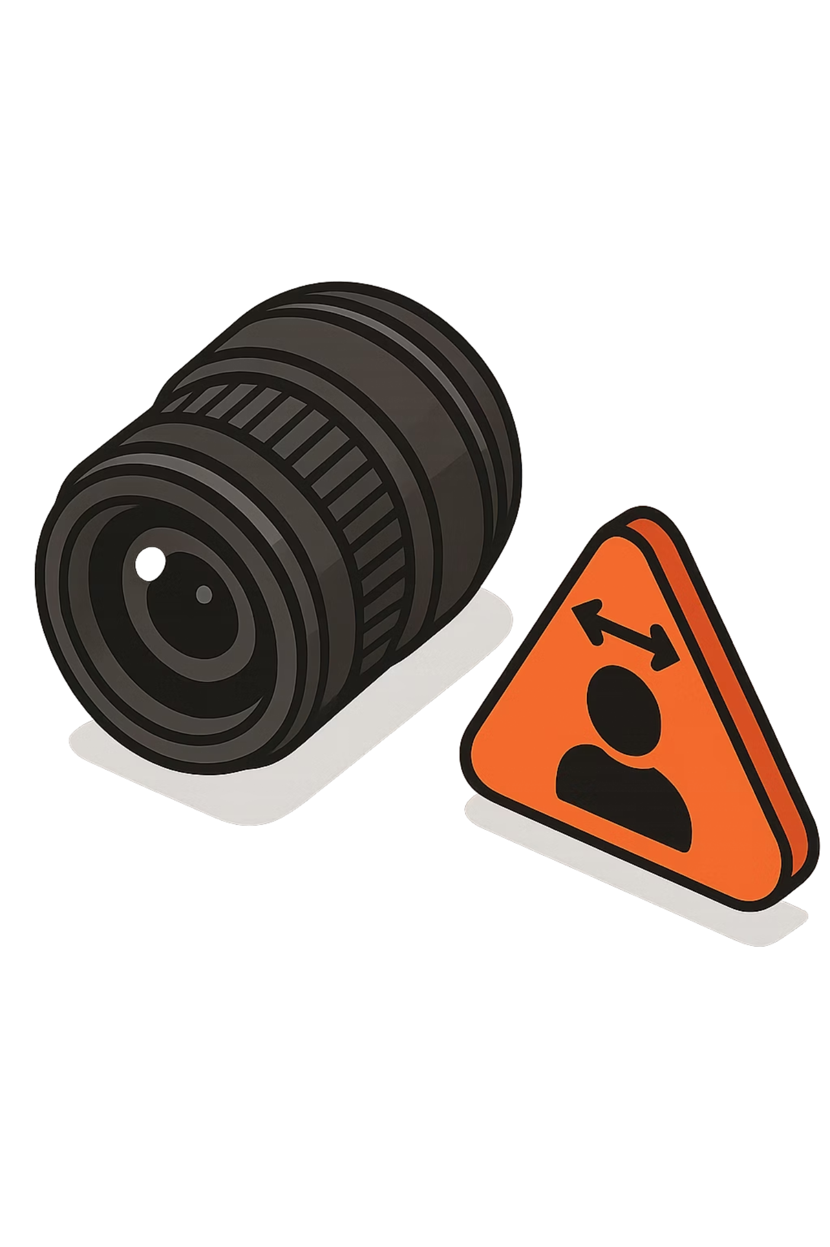
Object Detection
From seeing to understanding — detecting not just what is present, but where it exists.

Slide 2
Content
01
02
03
Foundations of Object Detection
Detection vs. Classification
Real-World Applications
Definition, outputs, and the mathematical formulation of structured prediction
Key conceptual distinctions in granularity, output complexity, and spatial reasoning
Autonomous vehicles, healthcare, retail, agriculture, and augmented reality
04
05
YOLO & SSD Architectures
Loss Functions & Python Implementation
How modern single-stage detectors work, from grid division to NMS
The multi-part loss formulation and hands-on code with Ultralytics YOLO

Slide 3
What is Object Detection?
Object Detection is a computer vision technique that identifies and localizes multiple objects within an image or video simultaneously — performing two tasks at once:
Model Output — for each detected object:
Classification
What objects are present?
Bounding box bi: rectangular region coordinates
Class label ci: category of the object
Confidence score pi: prediction certainty
Localization
Where are these objects located?
This makes object detection a structured prediction problem, not a simple classification task.

Slide 4

Object Detection vs. Classification
Image Classification
Object Detection
Assigns a single label to the entire image
No spatial information provided
Output: "This is a cat"
Global — one prediction per image
Identifies multiple objects in a single image
Provides precise bounding box coordinates
Output: "2 cats here, 1 dog there"
Local — many predictions per image
Classification is a special case of object detection where the entire image is treated as a single bounding box.

Slide 5




Applications of Object Detection
Object detection has become a cornerstone of modern AI systems, enabling machines to interpret visual scenes with the richness and specificity that real-world tasks demand. Its impact spans virtually every major industry.
Autonomous Vehicles
Surveillance & Security
Detect pedestrians, vehicles, traffic signs, and lane boundaries in real time to enable safe, reliable navigation at high speeds.
Identify suspicious activities, detect unauthorized intrusions, and track individuals across distributed camera networks.
Retail Analytics
Healthcare Imaging
Monitor customer behavior, detect empty shelves, count footfall, and track product interactions to optimize store operations.
Detect tumors, lesions, and abnormalities in X-rays, CT scans, and MRIs — supporting radiologists with automated second opinions.

Slide 6

More Real-World Applications
Manufacturing & QC
Agriculture
Augmented Reality
Identify defects on assembly lines in real time, reducing waste and improving product quality.
Detect pests, crop diseases, and estimate yield using drone or satellite imagery.
Enable object-aware overlays in real-time AR applications, anchoring digital content to physical objects.
Object detection is now a cornerstone of modern AI systems wherever detailed visual scene understanding is required.

Slide 7
Introduction to YOLO:You Only Look Once
YOLO, introduced by Redmon et al. (2016), fundamentally changed the object detection landscape. Rather than applying a region proposal network followed by a separate classification pass — as in Faster R-CNN — YOLO reframes detection as a single regression problem solved in one forward pass.
YOLO treats object detection as a single regression problem — predicting bounding boxes and class probabilities directly from image pixels in one forward pass. No region proposals. No two-stage pipeline.
In other words, It looks at the whole image at once and makes decisions instantly like humans.
Fast, simple, and built for real-time applications like video and live detection.

Slide 8
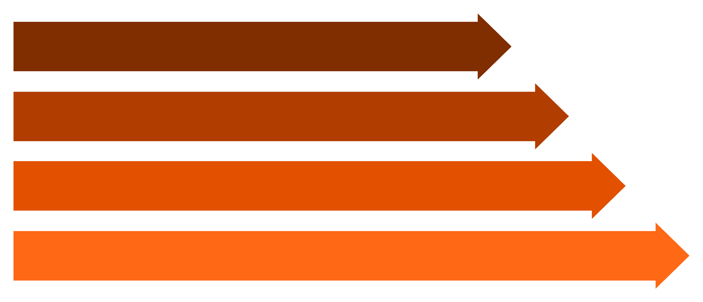
How YOLO Works
Grid Division
Box Prediction
Class Prediction
Combine & Score
Key insight: YOLO looks at the image exactly once — a single forward pass through the network yields all predictions simultaneously, enabling real-time detection speeds.

Slide 9
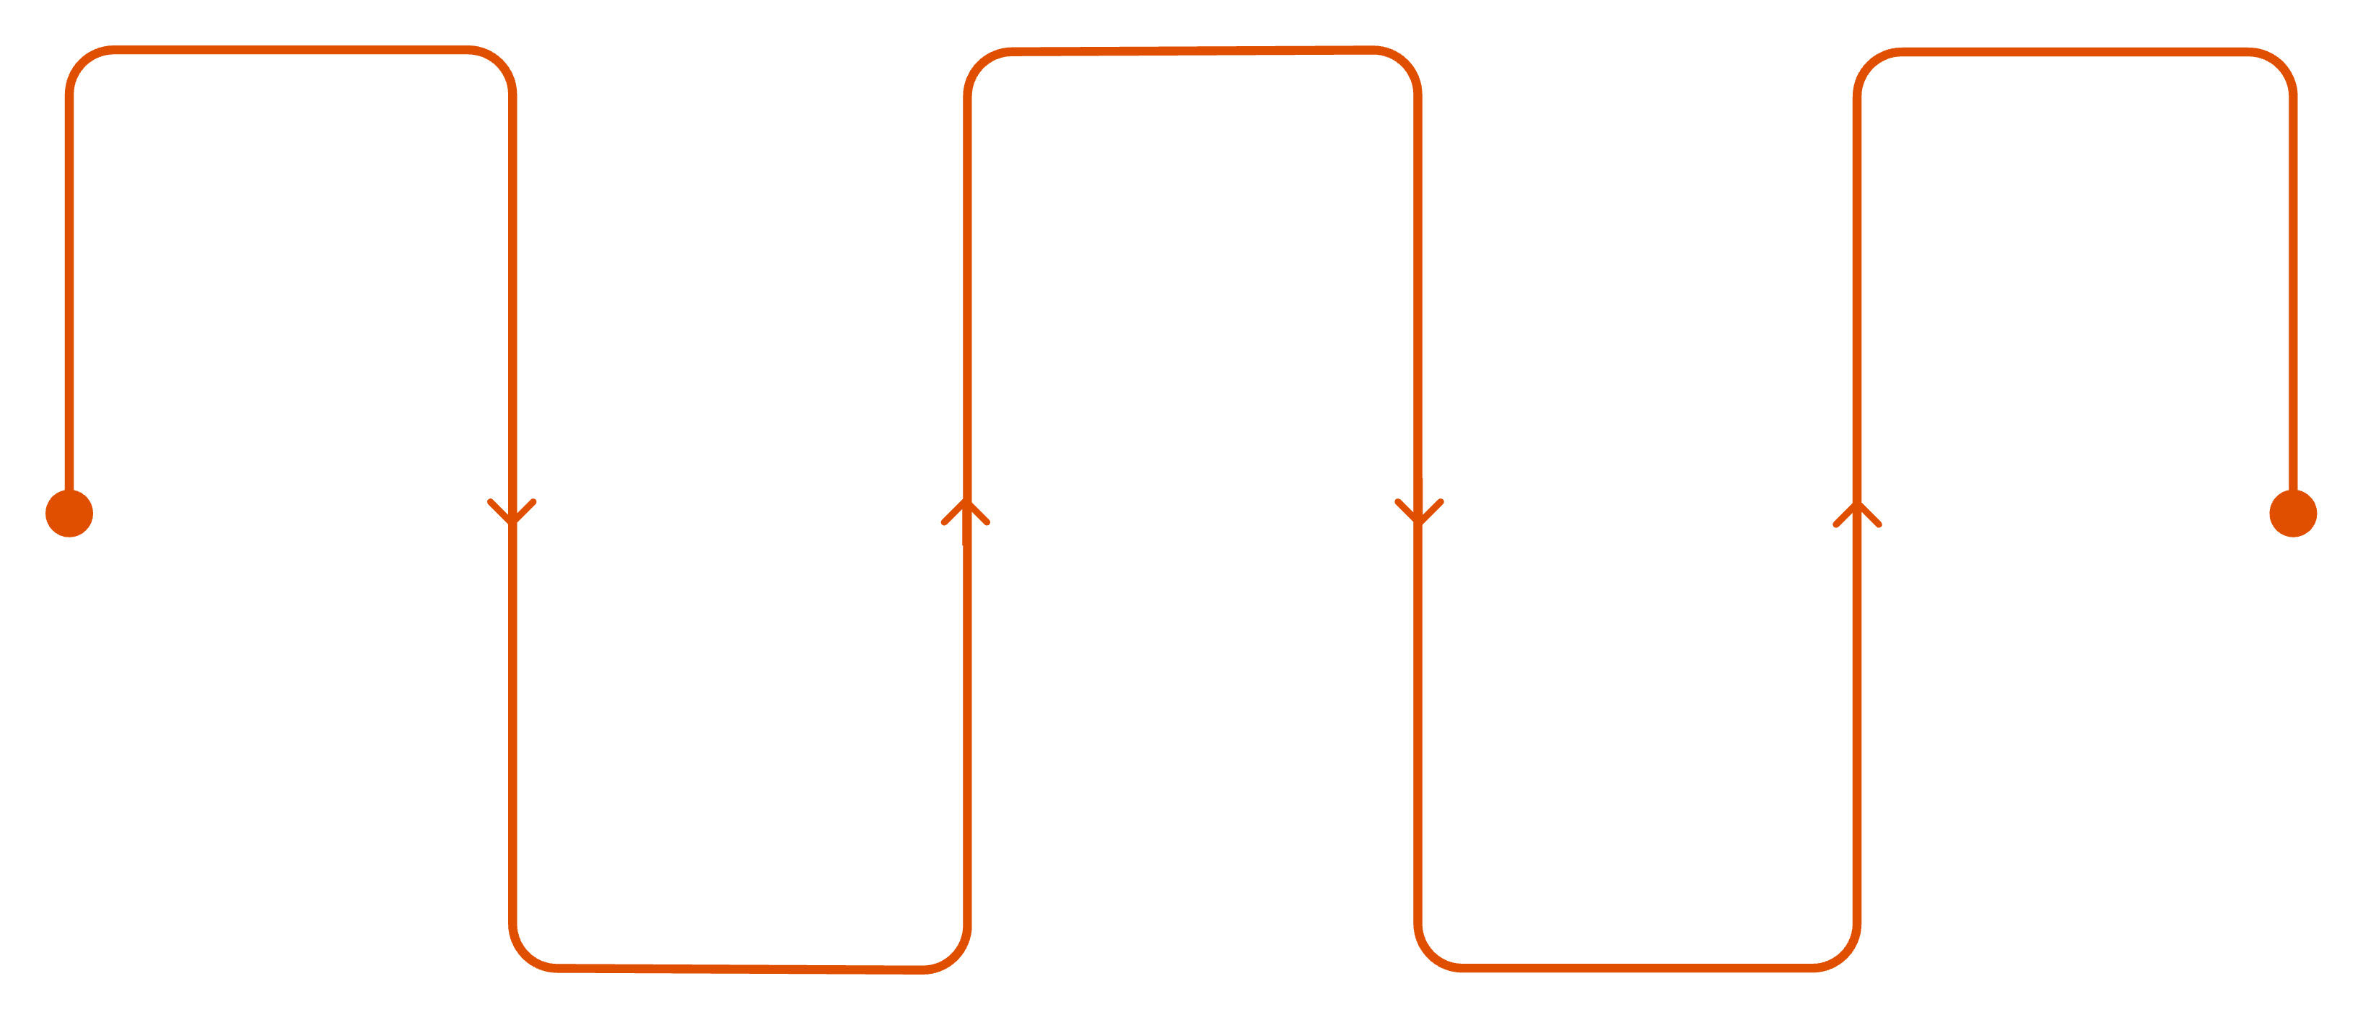
How YOLO Works — Step by Step
Grid Division
Class Prediction
Non-Max Suppression
Split image into S×S cells
Per-cell class probability scores
Remove duplicates, keep top boxes
Combine Scores
Box Prediction
Predict x,y,w,h and confidence
Confidence = P(object) × IoU
x: The x-coordinate of the box center (relative to the bounds of the grid cell).
y: The y-coordinate of the box center (relative to the bounds of the grid cell).
w: The width of the box (relative to the entire image).
h: The height of the box (relative to the entire image).
Confidence: How sure the model is that an object exists here and how accurate it thinks the box is.

Slide 10


How YOLO Works — Concept of Confidence
In YOLO, every predicted bounding box is assigned a confidence score that captures both whether an object exists and how well the box fits it. The formula is:
Breaking Down the Terms
IoU Formula
P(Object): Probability that an object exists in the grid cell. In ground truth, this is binary — either 1 (object present) or 0 (no object).
IoU(pred, truth): Intersection over Union between the predicted box and the ground truth box.
IoU measures the ratio of overlap to total coverage between two boxes:
Why Multiply Them?
Confidence is not just about detection — it penalizes poor localization too.
No Object Present
Object Exists, Perfect Box
Object Exists, Poor Box
P(Object) = 0 → Confidence = 0, regardless of the predicted box shape. The model is penalized for any false detection.
P(Object) = 1, IoU = 1.0 → Confidence = 1.0. The predicted box perfectly aligns with ground truth.
P(Object) = 1, IoU = 0.3 → Confidence = 0.3. The object is found but localization is weak, so the score is low.
When an object exists, confidence collapses to pure IoU. A perfect box scores 1.0; a misaligned box scores proportionally lower — making confidence a unified measure of detection quality and localization accuracy.

Slide 11



Feature Extraction in YOLO
YOLO leverages Convolutional Neural Networks (CNNs) to extract a hierarchical feature representation of the input image. This hierarchy is what allows a single model to detect objects at vastly different scales.
High-Level Features
1
Semantic concepts — "car", "person", "dog". Produced by deep layers; spatially coarse but semantically rich.
Mid-Level Features
2
Shapes, recurring patterns, and object parts — e.g., wheels, faces, windows.
Low-Level Features
3
Edges, corners, and textures — the elementary building blocks of visual structure.

Slide 12
The YOLO Loss Function
YOLO optimizes a composite multi-part loss that balances three distinct learning objectives:
Localization Loss
Confidence Loss
Classification Loss
Penalizes error in predicted bounding box coordinates (x, y, w, h). Uses MSE or IoU-based loss.
Penalizes incorrect object-presence predictions. Trains the model to distinguish object vs. background.
Measures error in predicted class probabilities. Typically uses Cross-Entropy Loss.
Modern YOLO versions use GIoU / DIoU / CIoU loss for more geometrically accurate bounding box regression.

Slide 13
Implementing YOLO in Python
Using the Ultralytics library — the modern standard for YOLO deployment:
# Install once: pip install ultralytics
from ultralytics import YOLO
import cv2
# Load pre-trained YOLOv8 nano model
model = YOLO('yolov8n.pt')
# Load image
img = cv2.imread('image.jpg')
# Perform detection (single forward pass)
results = model(img)
# Display and save output
results[0].show()
results[0].save(filename='output.jpg')
Expected Output
COCO Dataset Classes (sample)
Image with drawn bounding boxes
Class labels (e.g., person, car)
Confidence scores per detection
The default model detects 80 categories including: person, car, bicycle, dog, cat, traffic light, and more.

Slide 14
Introduction to SSD
SINGLE SHOT MULTIBOX DETECTOR
Core Idea
Trade-offs vs. YOLO
SSD detects objects at multiple scales simultaneously by leveraging feature maps of different resolutions from the CNN backbone — each map is responsible for objects of a specific size range.
Advantages
Limitations
Better multi-scale detection; faster than two-stage detectors like Faster R-CNN.
Slightly less accurate than newer YOLO versions; requires careful anchor box tuning.
Key Characteristics
Multiple convolutional feature maps
Predefined anchor boxes (default boxes) at each scale
Single-pass inference — no region proposals

Slide 15





Evolution of Object Detection
Traditional Methods
HOG+SVM, Viola-Jones, hand-crafted features
Two-Stage Deep
R-CNN family — high accuracy, slower
Single-Stage Detectors
YOLO, SSD — real-time speed
Modern Architectures
YOLOv8, DETR, Transformers — accuracy+speed
The field has advanced rapidly from hand-crafted features toward end-to-end trainable architectures that deliver both accuracy and real-time performance.

Slide 16
Key Takeaways
1
Detection = Classification + Localization
More complex than classification — outputs structured predictions with coordinates, labels, and confidence scores.
2
YOLO Revolutionized Speed
Single-pass inference enables real-time performance. End-to-end training with global image context.
3
Hierarchical, Multi-Scale Features
CNNs extract low → mid → high-level features. Backbone + Neck + Head architecture enables multi-scale detection.
4
Composite Loss Functions
Localization + Confidence + Classification losses jointly optimized. Advanced IoU-based losses improve box regression.
5
SSD Introduced Feature Pyramids
Multi-scale feature maps improve detection across object sizes — an idea carried forward into modern architectures.

